Slide 1

Cloud Migration

Slide 2






Cloud Migration
1
3
Evaluate
Migrate all app ?
Understanding about Legacy ?
On Prem Optimization”
Migrate all Infra ?
Redesign ?
Data Security ?
Risk ?
2
Plan ?
Evaluate?
4
KPIs for Resources?
Budget Planning
Identify Right Application
As-Is or Redesign
Level of Complexity
Identify the appropriate service in Cloud
App & Data security
Timeline to split & Move
Cloud Partner
Reference Architecture

Slide 3

Resource Utilization KPI

Slide 4

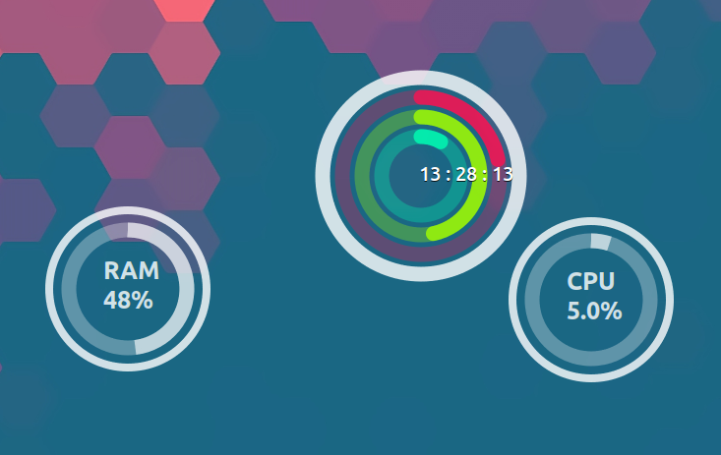

Resource Utilization - KPI
Key Areas
CPU Usage %
Memory Usage
Disk Performance
Network Usage
Database Storage
Integration systems if any (for ex: Queue, Data hub, etc.,)
No Of Servers or CPUs & time to create
What about Seasonal time or Offer time?
Resource Idle Time during the less usage
Infra Support
Time to create Infra
SLA for asset purchase
Hardware Maintenance
H/W or S/W out of support period?
Software licenses
Manpower to manage the resources
Time to create Infra
Datacenter for different location and its connectivity
On demand Resource Allocation
Simple and efficient use of resources
Transparent Cost Service of usage
Less time for maintenance
24X7 Support
Access Any where from the world
Less down time risk
3rd Party Tools
Scale up and Scale down
Availability
Reliability
Easy of Adaptability
Great Security features
Automatic backup
Many Dev Env in short time
Automatic deployment CI/CD– Time to market

Slide 5
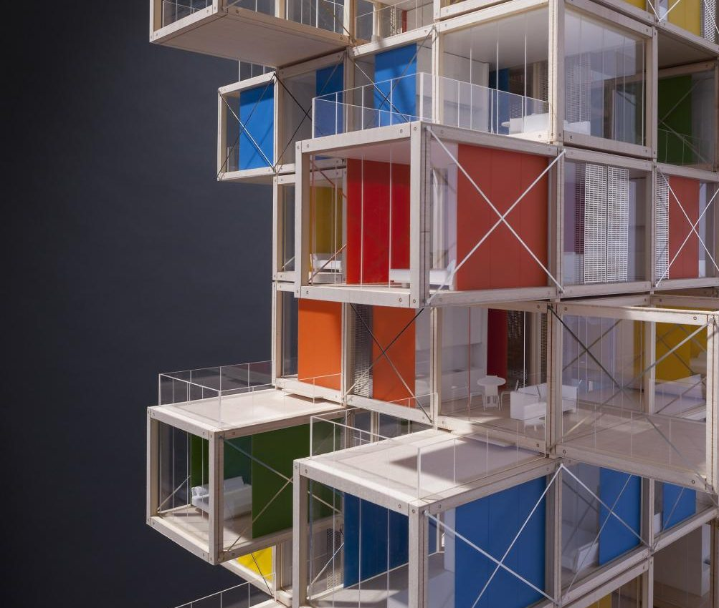
Reference Architecture

Slide 6
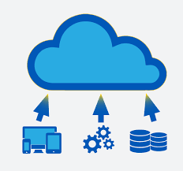
Why do we need Ref. Architecture ?
Points to be considered after the Evaluation & KPI Metrics analysis for ref. architecture:
Identify the real dependencies and chellenages
Pick unique functionality and break into multiple Micro Services
POC ( Proof Of Concept ) or Complex functionality
Networking Topology feasibility study
Hybrid connectivity if needed
Authentication and Authorization
Data Migration strategy
Availability check from the different Geo location
Configuration changes
Hardware Capacity
Backup and Restore
CI/CD Automation – Automatic Rollout
Logging and Monitoring
SaaS, Paas, and IaaS Service Models
Budget & cost (forecast)
Help us to draw the roadmap

Slide 7
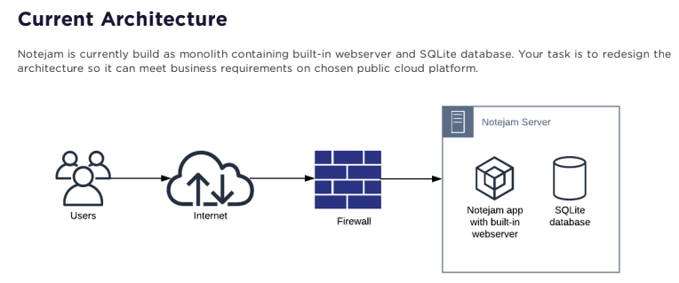
Ref. Architecture Case study

Slide 8


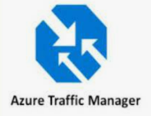


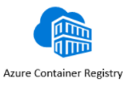


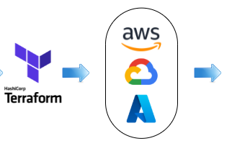
Microservice Architecture – K8s
Region - 2
LB or Gateway
nginx
K8s Cluster
Region - 1
LB or Gateway
LB or Gateway
nginx
Looping query collects metrices for every 15 secs
UI
UI
UI
Metric Server
Notejam-notejamapp.svc.cluster.local
1
POST/PUT/GET/DELETE
Calculate the replica based on the metrics
Pod-1
Pod-2
Pod-N
Scale up /down the Pods
Api
Api
UI
Api
UI
Api
UI
Api
3
2
Notejam-sqlite.notejamapp.svc.cluster.local
HPA
DB
DB
StatefulSet
DB
DB
DB
DB
PUSH
PULL
K8s Cluster
Health Check – Readiness and Liveness

Slide 9



Challenges with Case study:
Notejam app is not working as expected
I spent the considerable amount of effort to make it work
Little bit compatibility issues with respect to the Unit testing
Don’t have subscription to implement these features
I created a minikube in my local which has lot of limitations and even bugs.
Less freedom to work with minikubes with local environment.
Challenges with Case study:
The Customer takes guarantee to preserve your notes up to 3 years and recover it if needed.
1. Move the records to Archive database on daily basis using the DB scheduled job
2. Back up the database files , Full back and delta to update the changes.
Effective Monitoring and Logging implementation using the daemon set
Setup a dependent container (DB container must be ready before up the Notejam App)
PSV and PSVC will be incorporated for the DB stateful sets , the same will be included in the backup.
NSG resource needs to be implemented and allow only the specified traffics to the respective backend
Backup of database volumes /Storage
Yet to cover the Unit testing
Yet to Cover the different Env deployment for developers
Metric dashboard need to add.
Continuity plan needs to be discussed with customer and align our implementation accordingly

Slide 10

Feedback about the case study
Really Excellent real-world example to migrate to cloud
Use cases are exactly matching with real customer need with current world
Provide the working version of solution
It would be great if you provide the free subscription to implement the changes

